Slide 1



Presentasi Tugas Materi Javascript 1
Tugas 1
Tugas 2
Tugas 3
Ridhwan Muhammad Zaki

Slide 2
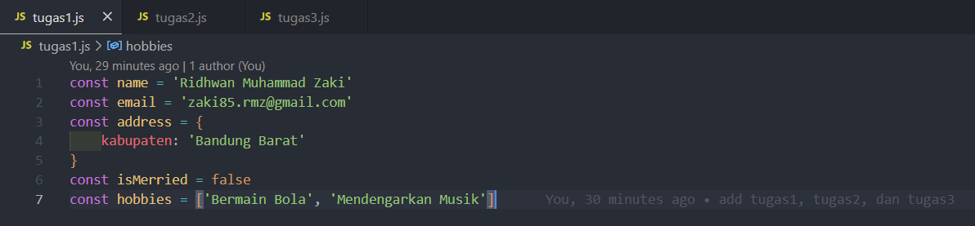

Tugas 1

Slide 3
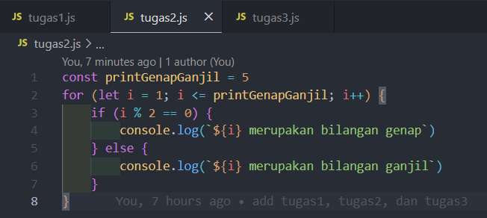
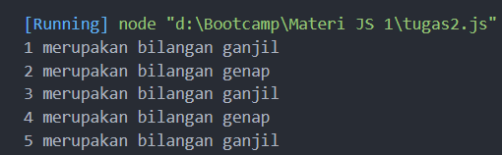
Tugas 2
Output

Slide 4
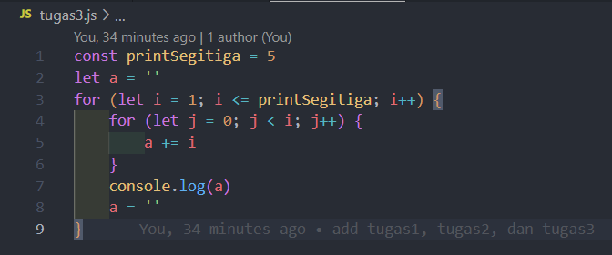
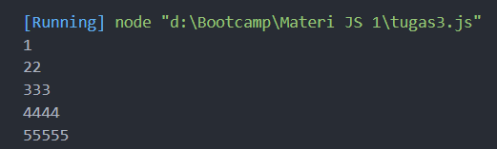
Tugas 3
Output

